Slide 1

FASD and Mental Health: A Lifetime Relationship
Presented by
Rob More
Maude Champagne
Karen Moore

Slide 2


Thank you to our Sponsor
The best mental health and well-being for every child, youth and family.
cymh.ca
Notes:
We want to take a moment to thank and recognize our partners at the Ontario Centre of Excellence for Child and Youth Mental Health for supporting this year’s first ever CMHO VIRTUAL Conference.

Slide 3
FASD Facts
Approximately 4% of the population have FASD or more than twice as prevalent as ASD - https://canfasd.ca/wp-content/uploads/2018/08/Prevalence-1-Issue-Paper-FINAL.pdf
Annual Cost in Canada is 9.7 billion dollars. https://jptcp.com/index.php/jptcp/article/view/281
According to the CanFASD database, approximately 13% of children diagnosed with FASD have all three sentinel features.
Estimated 90% of individuals with FASD in Ontario currently undiagnosed due to a 68-fold increase needed in diagnostic capacity within Canada. https://www.cmaj.ca/content/cmaj/188/3/191.full.pdf
428 co-morbid conditions associated with FASD with mental health and sensory challenges being the most prevalent. https://pubmed.ncbi.nlm.nih.gov/26777270/

Slide 4
Characteristics of FASD
Read Article: https://www.cbc.ca/news/canada/ottawa/sisters-living-with-fasd-point-of-view-1.4970670
They will likely have cognitive impairment including intellectual functioning (IQ), executive functioning (EF), learning and memory, language and communication, visual-spatial abilities, motor function, attention and activity, academic achievement
Social, adaptive and emotional skills will also likely experience uneven development.
All of this means they will likely experience difficulty learning from mistakes, anticipating consequences and maintaining emotional and impulse control.
They tend to have extreme safety responses exhibiting fight, flight, freeze, fawn, and faint when overwhelmed. https://pubmed.ncbi.nlm.nih.gov/18825524/

Slide 5
Diagnosis Process
Only medical practitioner using 2015 Canadian Guidelines can diagnose https://www.cmaj.ca/content/cmaj/188/3/191.full.pdf
Requires an OT assessment, SLP assessment, Psychological assessment, Social history and Facial assessment.
Current waitlist is 5-6 years or $5000-$7000 privately.
There are currently 14 publicly funded and 1 private clinic in Ontario. However, only CHEO in Ottawa and NorWest in Thunder Bay don’t have defined catchment areas. https://canfasd.ca/wp-content/uploads/2018/06/ON-FASD-English-FAQ-card-2018-06-25.pdf
Largest challenge is there is currently no OHIP code diagnosing FASD which impacts tracking purposes, establishing best practices and increasing capacity.

Slide 6
Referral Process
MCCSS through Coordinating Service Agencies hired 50+ FASD workers two years ago. They serve as social workers, system navigators and point of contacts for referrals. There will be someone assigned to your area. Please reach out to your local worker to find out where diagnostic referrals should go.
https://docs.google.com/document/d/1sTpXYpp9GXTQPoZnzAZl-wnDY-Qk9SKWlpJsMv_on4g/edit
To access this worker, MCCSS established any professional who in their judgment suspects someone may have FASD, they may refer to the FASD worker. Individuals and/or their caregivers can also self-refer.

Slide 7
Protective Factors for Positive Outcomes
Read Article: https://canfasd.ca/wp-content/uploads/2019/11/Final-Towards-Healthy-Outcomes-Document-with-links.pdf
This is the document you will want to read, particularly p.20-22 around the importance of collaboration within organizational capacity.
British Columbia and Alberta just concluded their ten-year studies on the effectiveness of their provincial strategies in 2019. This document summarizes the findings from those studies.
Acknowledgement must be given to CanFASD (Canadian FASD Research Network) who maintain the national database on FASD prevalence, policy development, online courses, and a library that contains all Canadian FASD research studies. Kids Brain Health Network is also a wonderful research partner.

Slide 8
Summary
The traditional life trajectory of someone with FASD is full of trauma, shame, stigma and negative outcomes resulting in a short life expectancy.
However, the initial step to positive outcomes is diagnosis and support for their entire network. We also know 90% of children with FASD will have mental health challenges by age 18. As a mental health practitioner, you are uniquely positioned to help identify and refer a child with FASD and their caregiver more than any other person they will meet.
The Rural FASD Support Network intentionally focused on our local SLP’s and Children Mental Health organizations to help bring awareness and collaboration between our 120 families and 154 children with FASD to have the largest possible impact on their lives.

Slide 9
FASD and Trauma
According to CanFASD's National Database, most people diagnosed with FASD don’t live with their biological parent, more than 15% of people diagnosed with FASD have attachment difficulties and more than 40% have trauma.
Among patients with FASD, the most common childhood adversity experiences are: neglect (87%), substance abuse by parents (85%), parental separation or divorce (50%) and physical abuse (50%) Kambeitz et al. (2019).
FASD and developmental trauma have very similar symptoms.

Slide 10
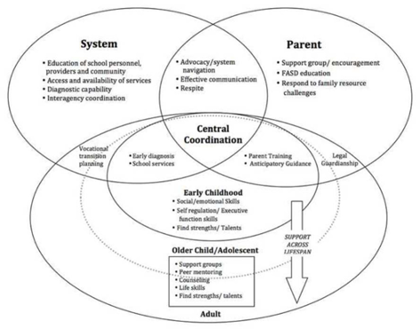
Intervention and FASD
Lifelong support for a permanent condition

Slide 11
Fetal alcohol spectrum disorder (FASD): A beginner’s guide for mental health professionals
Read: https://www.pulsus.com/scholarly-articles/fetal-alcohol-spectrum-disorder-fasd-a-beginners-guide-for-mental-health-professionals-4201.html
Memory Problems
Suggestibility
Confabulation
Adaptive and Functioning skills

Slide 12
DDP and FASD: My thesis
FASD and developmental trauma: a similar experience?
DDP and FASD: a good fit?
Rethinking parenting to the child’s cognitive impairments:
Parents experienced DDP as a very different approach to anything they had tried before. This fits with DDP’s development, where Dan Hughes identified that a different approach was required for treatment of developmental trauma (Hughes, 2014). Traditional behavioral approaches are not considered to accommodate the neurodevelopmental effects of maltreatment (Wingfield & Gurney-Smith, 2018, p.13-14).

Slide 13
Dyadic Therapy
To accommodate cognitive impairments
To model intersubjective communication
To support the parent in their role
To prioritize the parent-child relationship

Slide 14
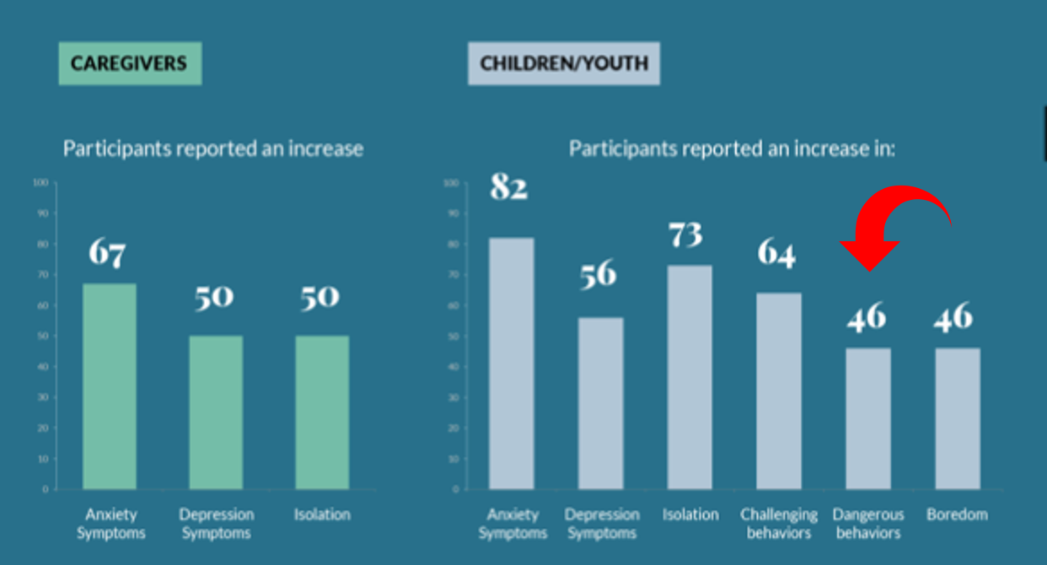

Slide 15
So what does this mean for me… as a mental health professional?
Keep learning about FASD https://canfasd.ca/ and https://www.fasdinfotsaf.ca/en/
It’s not always FASD and sometimes it is---be aware of your own biases and assumptions (and possibly your agency biases or assumptions) about FASD---who are the birth parents? What does FASD “look like” in children/youth? https://ken.childrenshealthcarecanada.ca/xwiki/bin/view/FASDScreeningToolkit/National+Screening+Tool+Kit+for+Children+and+Youth+Identified+and+Potentially+Affected+by+FASD
Remember the barriers to diagnosis----many may have FASD but don’t have the diagnosis of FASD https://canfasd.ca/wp-content/uploads/publications/FASD-Clinic-Process.pdf

Slide 16
And Still More…
Understand key concepts of FASD so you can see them when they occur---confabulation, patterns of knowing and then not knowing, fight, flight, freeze, fawn or faint! https://youtu.be/NdANbWlpJm4
Looking at how to support parents---in the unpredictable, often unrecognized world of FASD https://canfasd.ca/wp-content/uploads/publications/CanFASD-Caregiver-Guide-to-Diagnosis-Jan2020-interactive.pdf
Review your intake, assessment and intervention strategies to ensure that you are creating an environment where FASD can be explored, talked about, supported https://canfasd.ca/wp-content/uploads/2018/09/Best-Practices_June12018.pdf

Slide 17
And Finally…
Look at the way you do your work to incorporate the sensory, relational and environmental needs of someone with possible FASD i.e. length of sessions/interventions, repetitive, remembering confabulation and information accessibility, tolerance needs https://youtu.be/U4FlZrxE4AQ
Helping to create interventions and support that recognize the inconsistent development pattern—this includes helping parents understand how to parent from this perspective---decoding behavior based on developmental age in each developmental stage http://www.knowfasd.ca/
Create (or continue to create) partnerships with community resources to build a team for the child/youth/family---education, police, FASD key workers, parent support, peer support, recreation, work environments https://canfasd.ca/topics/interventions/best-practices/

Slide 18
Exit Poll
We now ask you to participate in the following poll to give us feedback as to the effectiveness of our presentation and what next step and future presentations we should explore.

Slide 19
Short Answer Questions
We would ask you to use the chat function now to answer the following questions:
Based on this presentation, what areas of need if any have you identified within your practice and/or organization?
Have you identified a next step for changing your practice, processes and methods and if so, what will it be?
What other topics on FASD and Mental Health would you like to learn about?

Slide 20






Innovating and Advancing Child
and Youth Mental Health
November 23 to December 4
Sponsored by
Notes:
Host: Kim Moran

