Slide 1




Innovating and Advancing Child
and Youth Mental Health
November 23 to December 4
Sponsored by

Slide 2
Building Stronger Bridges
Successful Transitions from Child Mental Health Services
Kristin Cleverley RN PhD CPMHN
Emma McCann HBSc

Slide 3
The Cleverley Lab partners with youth and caregivers to co-design research that will improve mental health service access, transitions, and continuity of care.

Slide 4
Polling Question
What hat are you wearing?
Notes:
Clinician
Service provider
Admin
Youth
Caregiver/Family member
Researcher
Policy maker

Slide 5
Polling Question
Do you have personal or professional experience navigating care transitions?
Notes:
Yes/No

Slide 6
Polling Question
Are you aware of care transition resources within your organization?
Notes:
Yes/No

Slide 7
1
Learn about a national study identifying priorities in youth mental health transitions with youth, parents/caregivers, and clinicians/administrators.
2
Understand the core components of successful mental health transitions prioritized by these stakeholder groups.
Objectives
3
Discuss the implementation of core components through transition policies and interventions, including key tools and resources to support their adaptation in your context.

Slide 8
1
Why Transitions Matter
2
Core Components of Transitions
3
Identifying Core Components
Overview
4
Operationalizing Core Components
5
What’s Next?

Slide 9


Slide 10


Slide 11


Slide 12
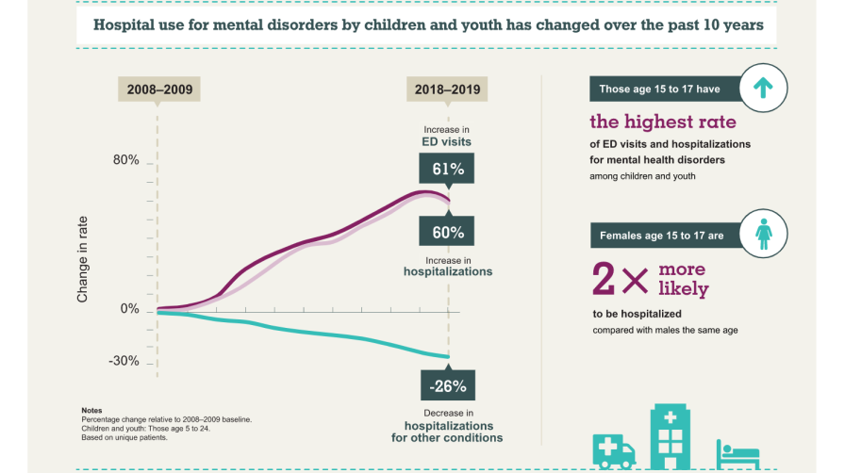
Canadian Institute for Health Information, Child and youth mental health in Canada [infographic]. 2020.

Slide 13
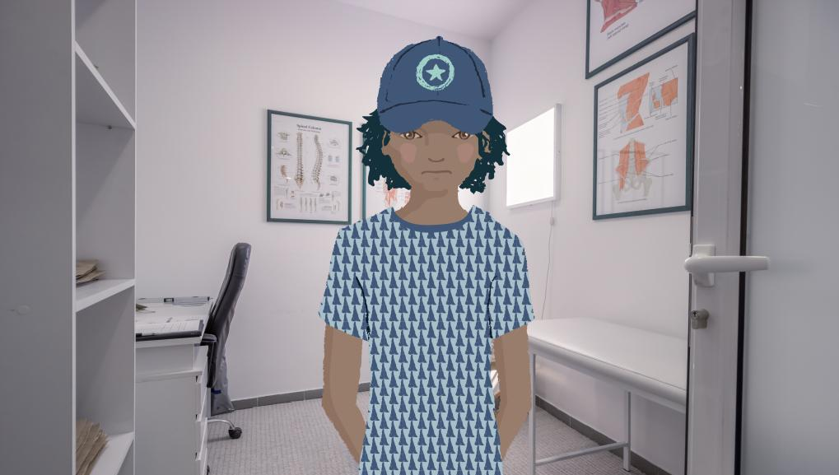
[Illustration of Lee in a doctor’s office]

Slide 14
“My appointment will be in December. However, as of right now I have no idea what will be happening because of the pandemic.” [LYiTS Study Participant, Fall 2020]

Slide 15


Slide 16
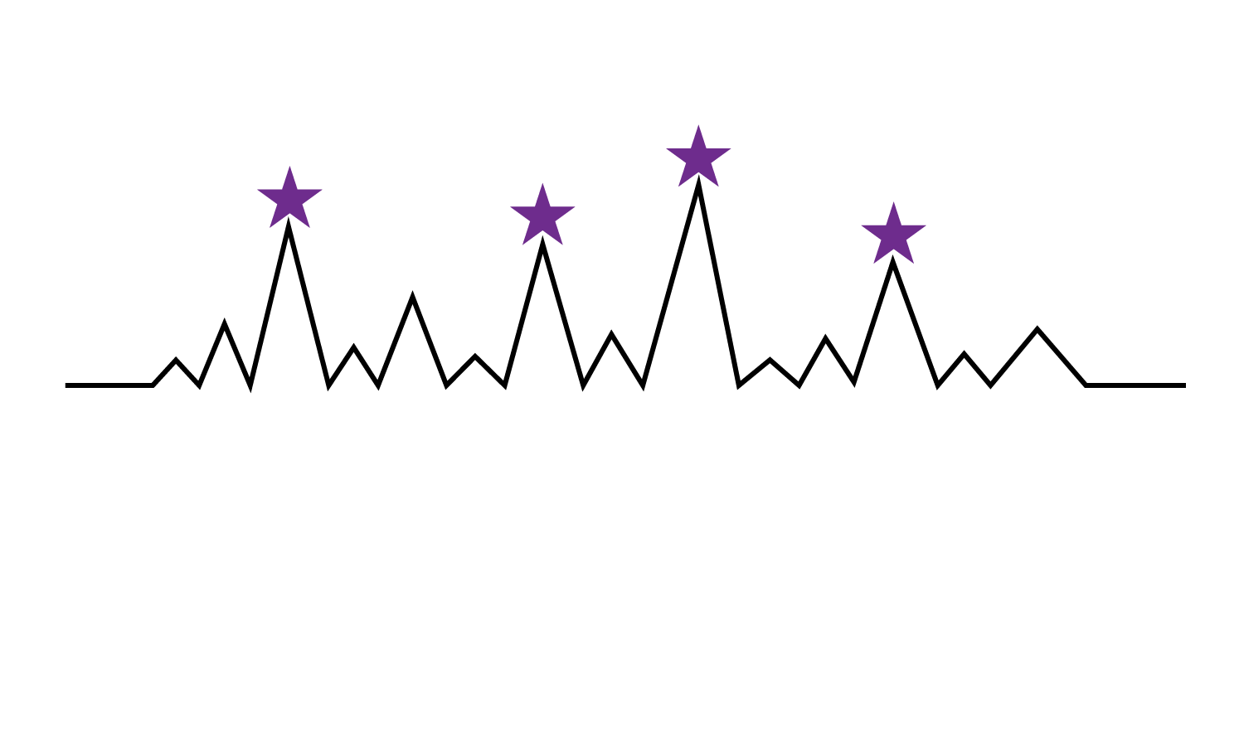


Slide 17
Core Components of Transitions from Child & Adolescent Mental Health Services
Notes:
K

Slide 18
What do we mean by core components?

Slide 19
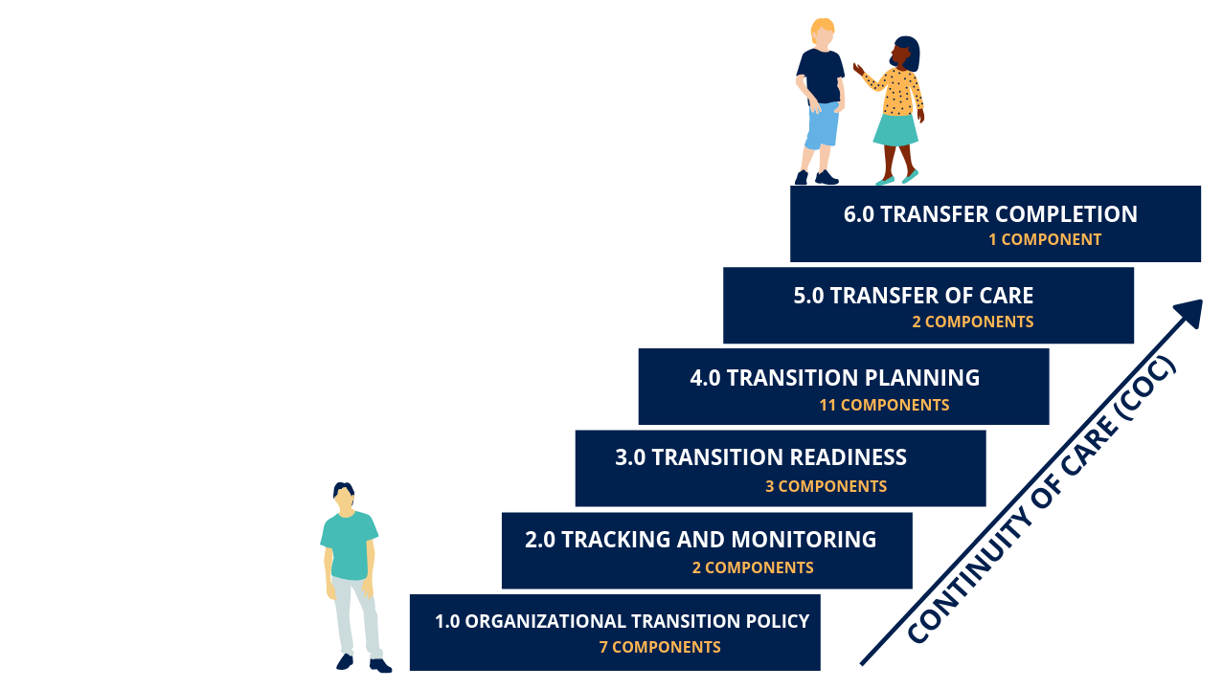

Slide 20
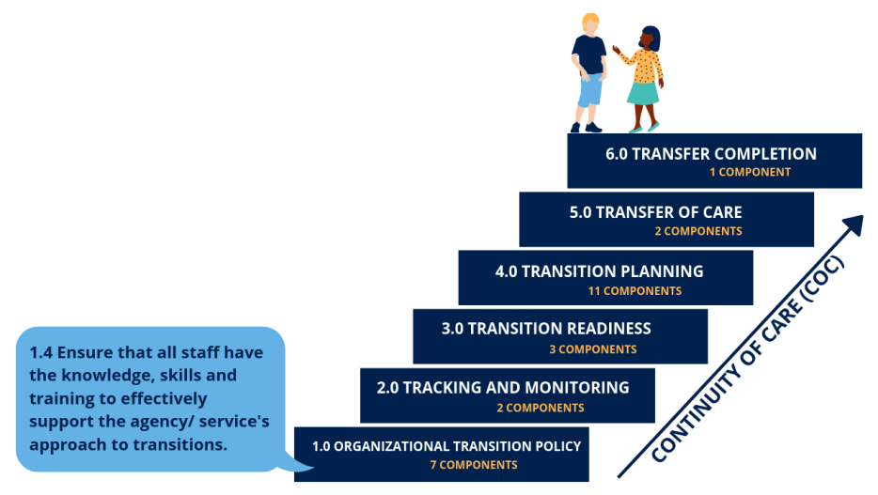

Slide 21
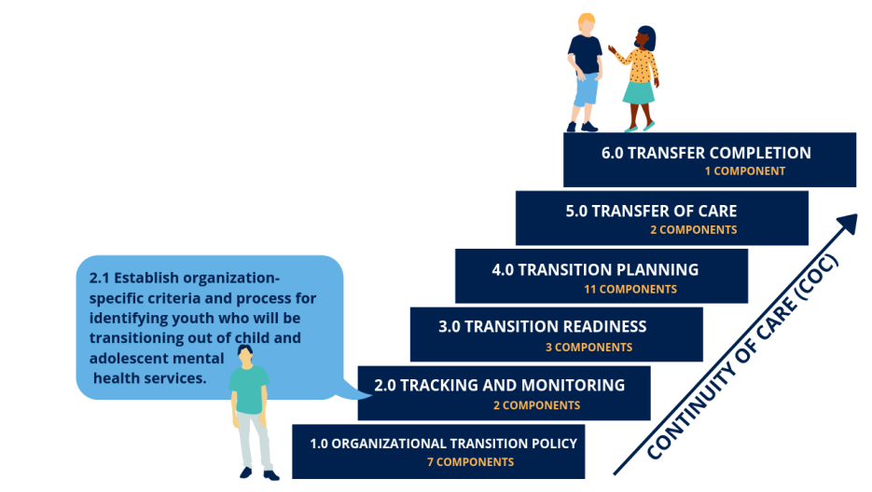

Slide 22
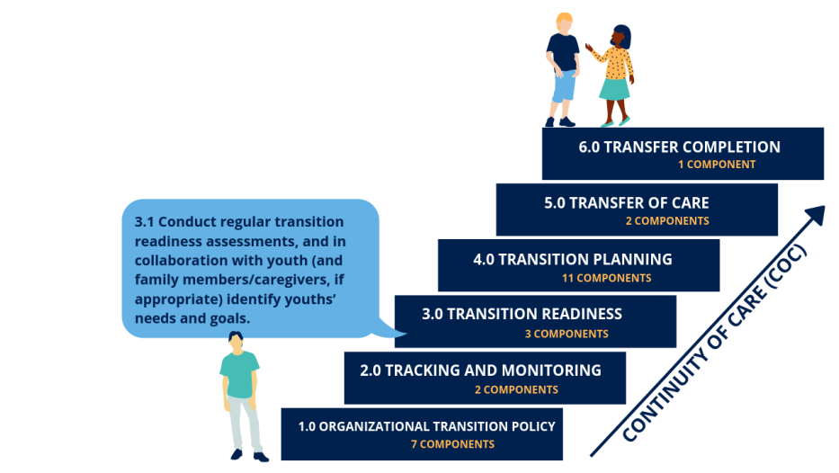

Slide 23
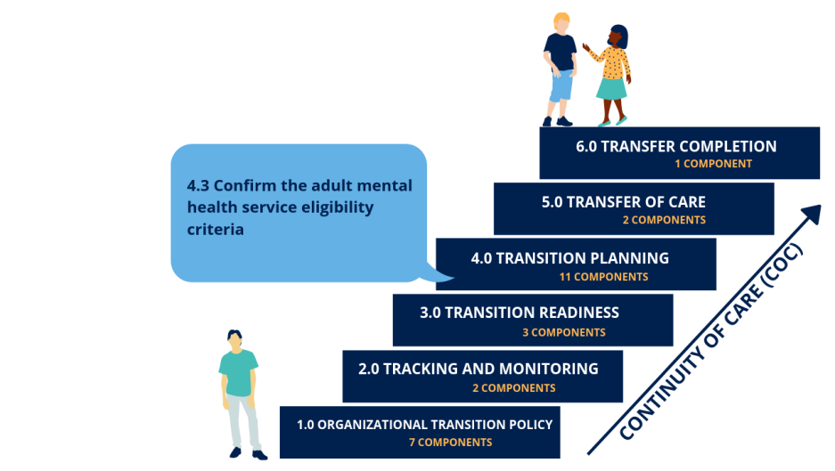

Slide 24
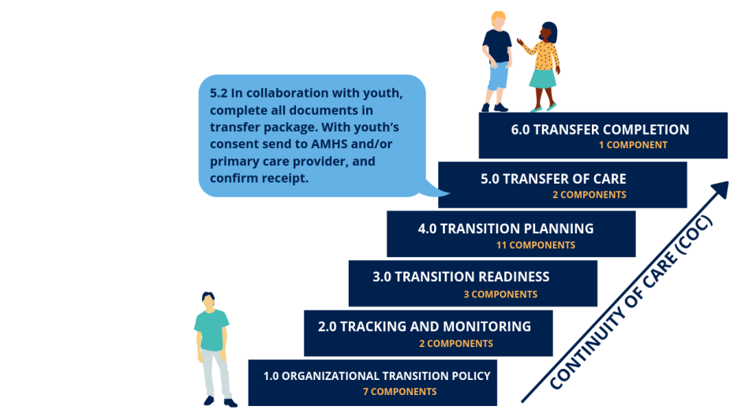

Slide 25
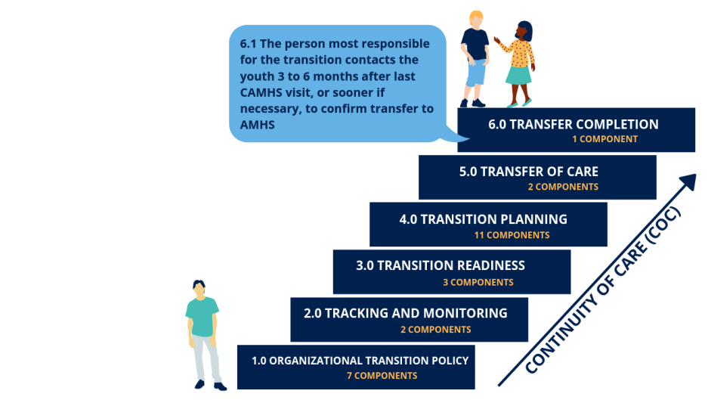

Slide 26
Developing Core Components

Slide 27



Expert Advisory Committee (EAC)

Slide 28
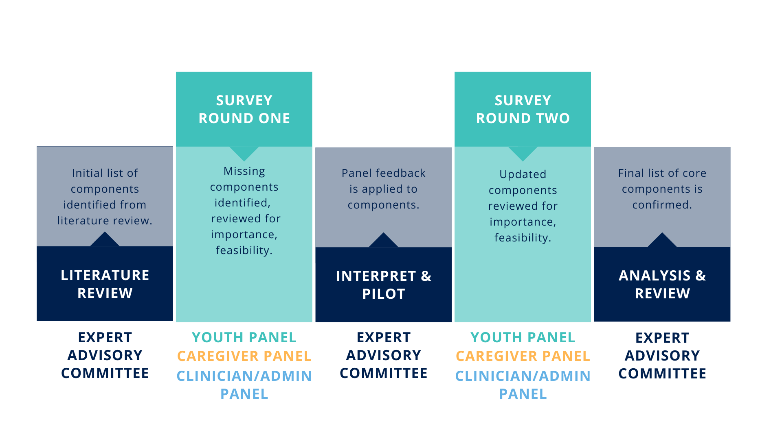

Slide 29




Slide 30


Slide 31
Original Core Component
Round 1 Revisions
Round 2 Revisions
1.5 Determine clear role for all individuals (youth, caregivers, CAMHS and AMHS staff) involved in the transition process
Determine clear role for all individuals (e.g. youth, child and adolescent mental health services and adult mental health services staff, peer support workers, transition workers, and family members/ caregivers, if appropriate) involved in the transition process
Determine a clear role for all individuals (e.g. youth, child and adolescent mental health services and the adult mental health services staff, peer support workers, transition workers, and family members/ caregivers, if appropriate) involved in the transition of care, informed by the needs of each youth

Slide 33
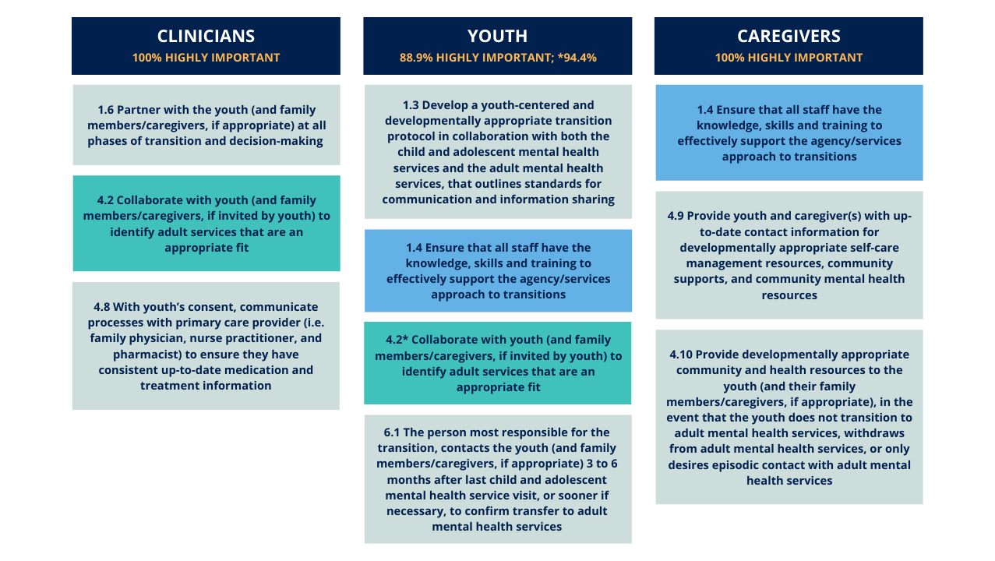

Slide 34
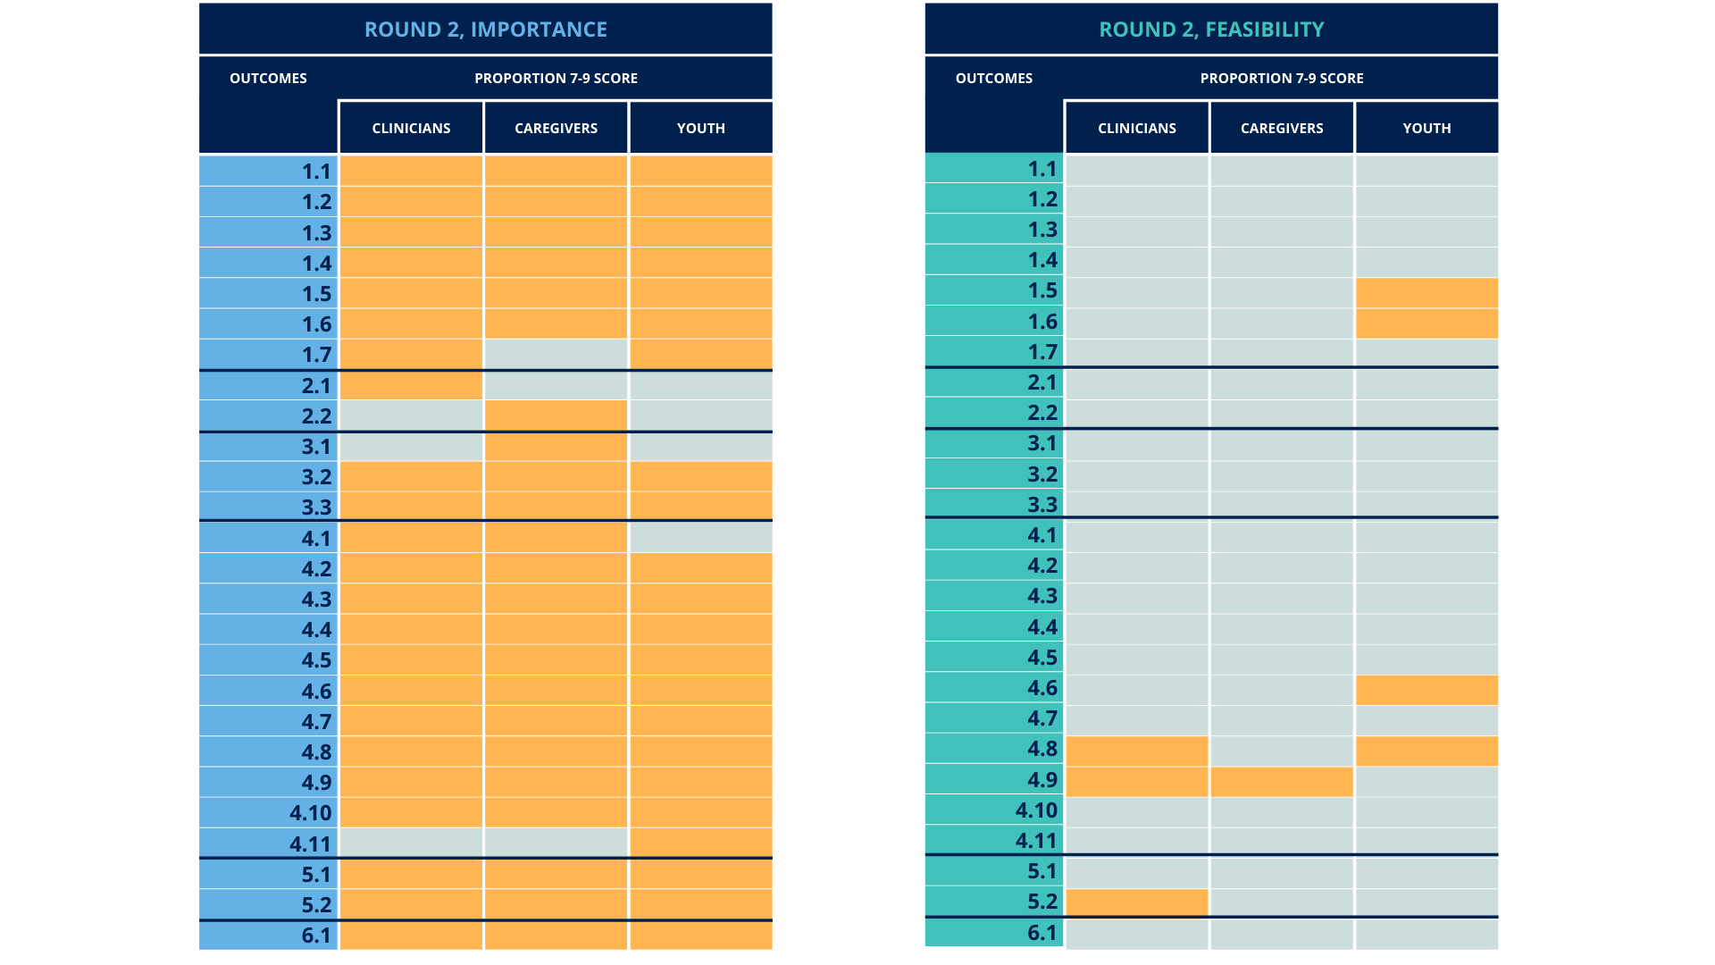

Slide 35
Implementing Core Components

Slide 36
CHALLENGES AND FACILITATORS
in the implementation and uptake of core components
Notes:
K

Slide 37
Notes:
K

Slide 38
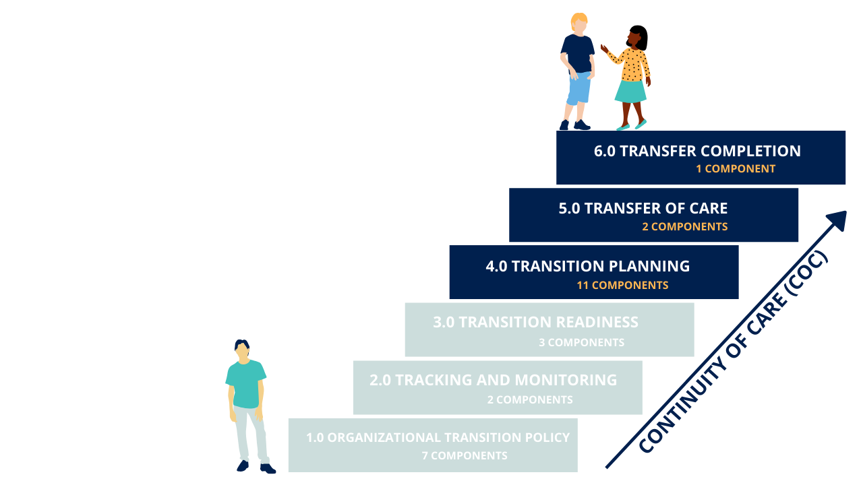
Notes:
K

Slide 39
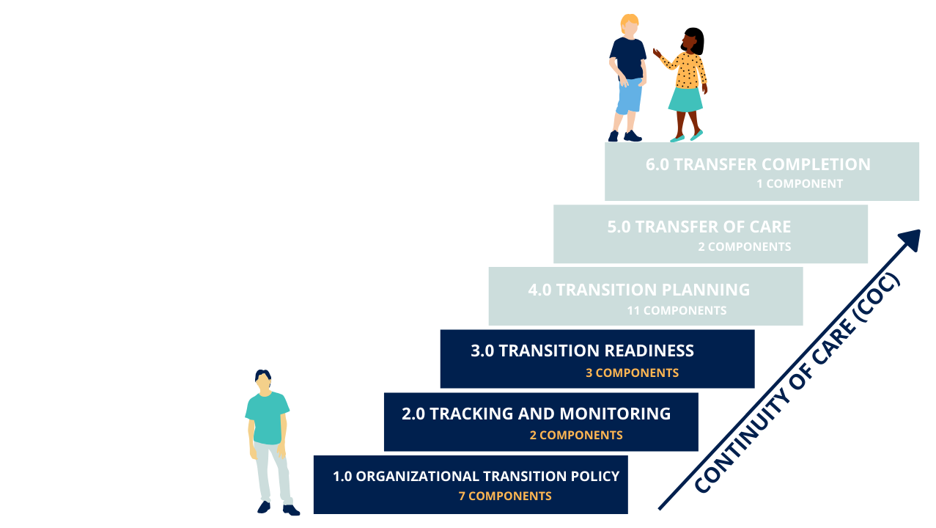
Notes:
K

Slide 40
Strategic integration of stakeholder perspective
Cross-sectoral lens
Facilitators in care transitions
Focus on whole community readiness
Transparency of process
Equal voice to all stakeholders

Slide 41
5 recommendations for implementation

Slide 42

Components do not need to be implemented all at once.

Slide 43
Components should be adapted to suit your context.

Slide 44
Organizational
Community
Context matters!
Individual
Global

Slide 45
Transition Protocols
1.3 Develop a youth-centered and developmentally appropriate transition protocol in collaboration with both the child and adolescent mental health services and the adult mental health services, that outlines standards for communication and information sharing.

Slide 46


Transition Protocols

Slide 47
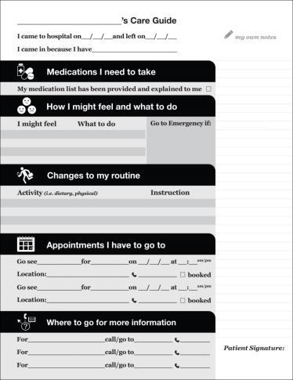

PODS Discharge Summary
Component 4.5, 4.9, or 5.2

Slide 48
Focus on readiness & capacity building.

Slide 49
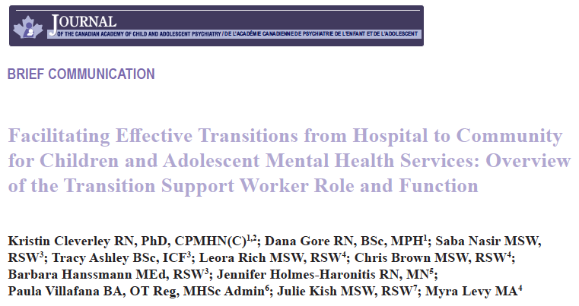

Care Navigator
4.6 Identify the most responsible person (i.e. child and adolescent mental health services clinician, transition worker) to coordinate the transition process, act as the main contact, and ensure continuity in the youth’s care.

Slide 50
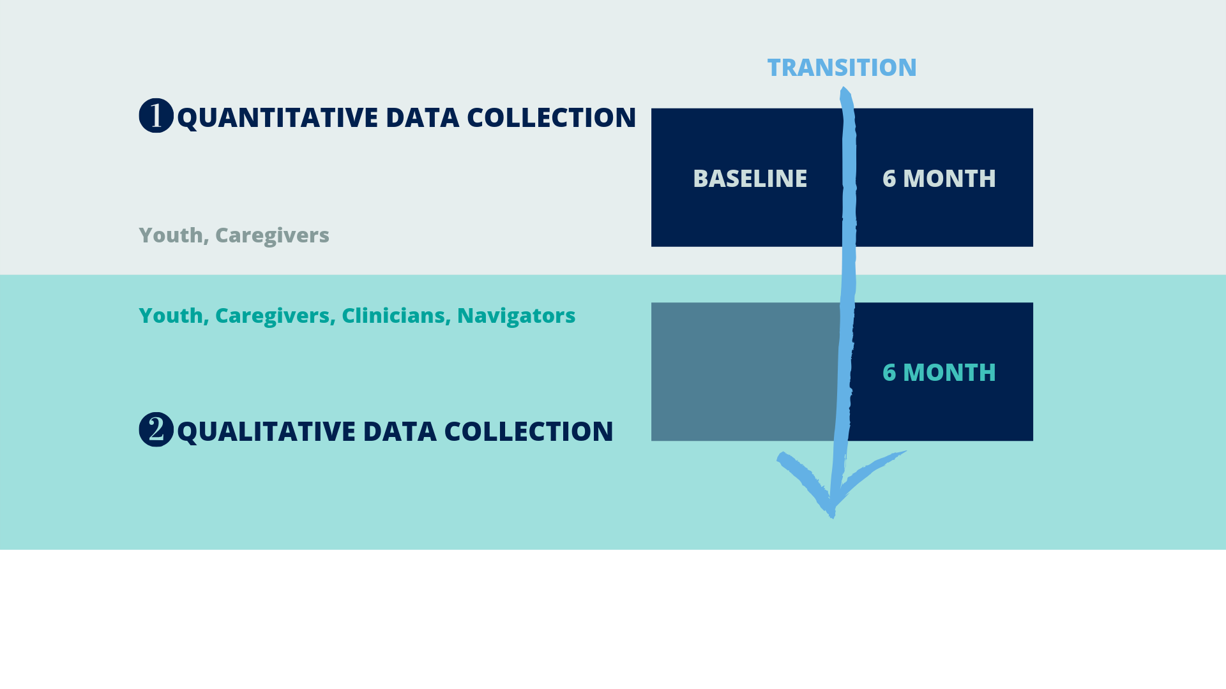




Slide 51
Prioritize through policy and process.

Slide 52
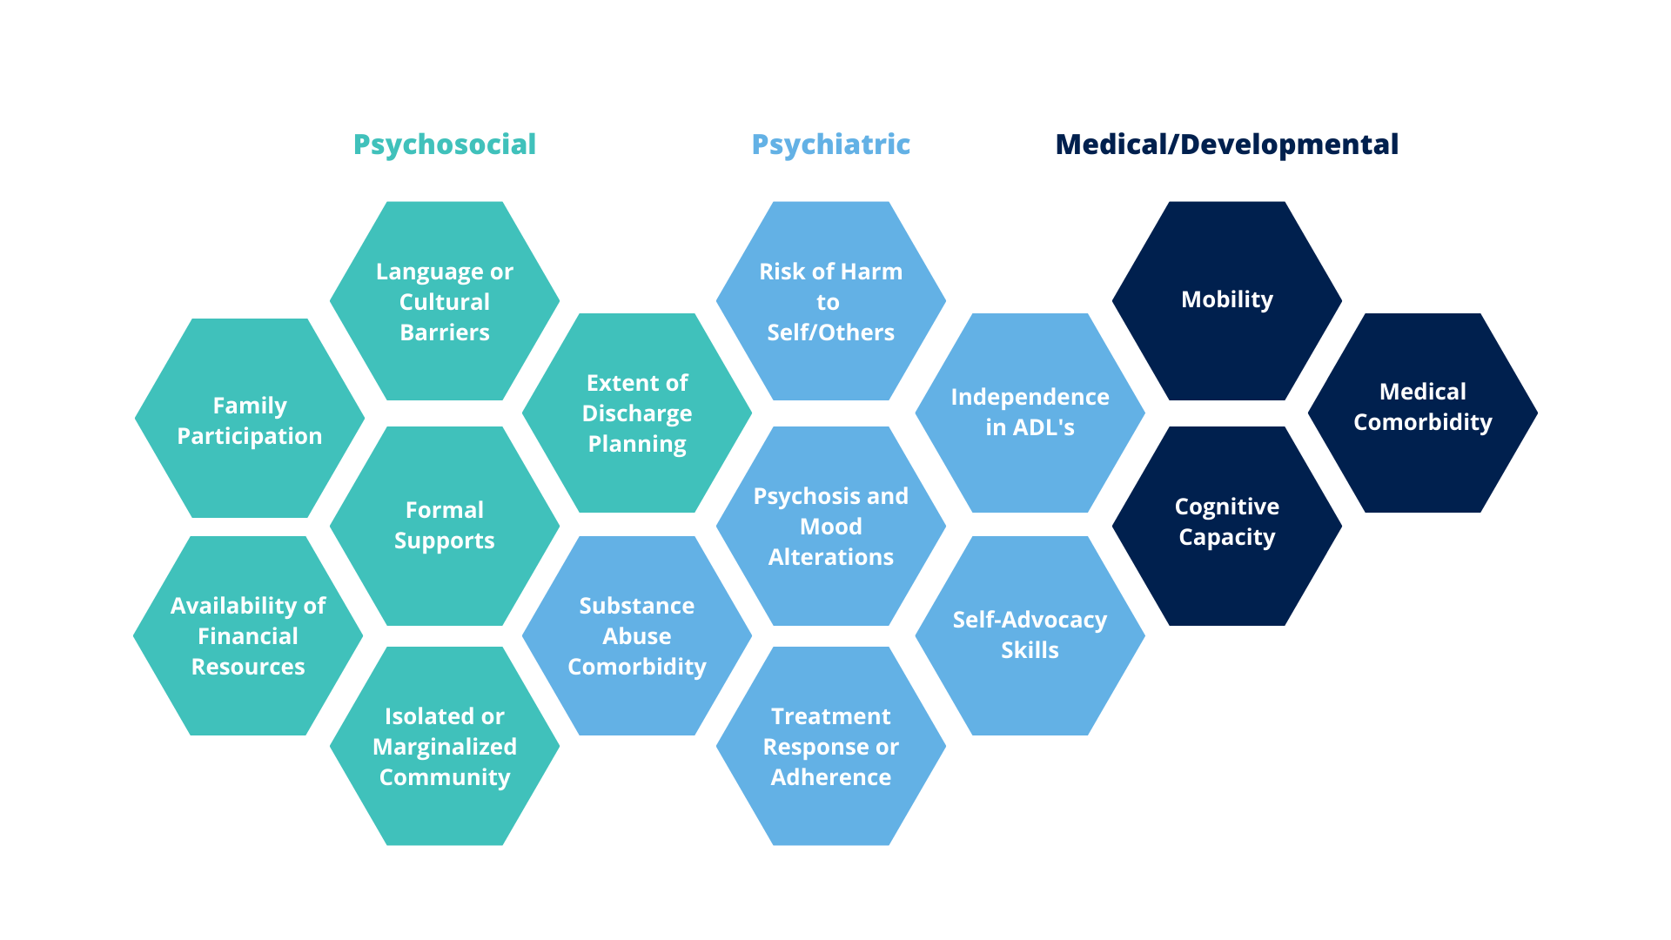

Slide 53
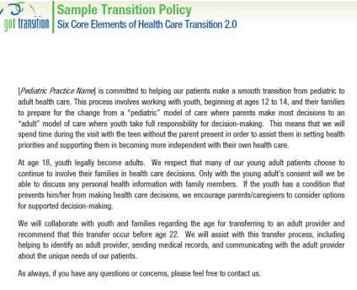
Transition Policy
1.2 Develop an organization-specific transition policy with youth (with input from family members/ caregivers) that describes the organization’s approach to mental health care transitions, and make it publicly available.

Slide 54
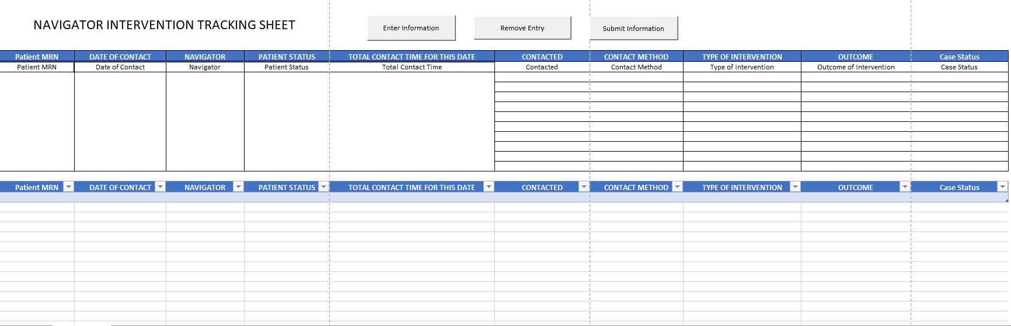
Care navigator tracking database
2.2 Establish a transition flow sheet or log book that tracks the completion of important steps as youth transition out of child and adolescent mental health services.

Slide 55
Evaluate at every stage.

Slide 56

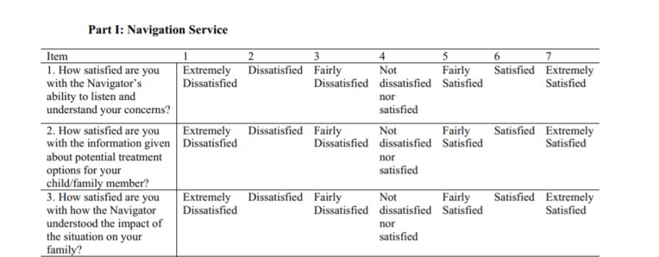
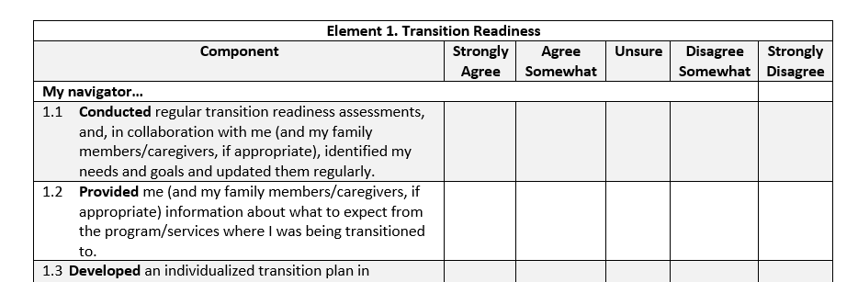
Care Transition Measures
Navigation Satisfaction Tool (NAVSAT)
Core Components Of Effective Youth Transition (CCEYT) Checklist
Notes:
Fishman, K., Levitt, A., Markoulakis, R., Weingust, S. Satisfaction with mental health navigation services: Evaluation with a new scale. (2018). Community Mental Health Journal, 54(5), 521-532. https://doi.org/10.1007/s10597-017-0201-0

Slide 57
Transition Follow up
6.1 The person most responsible for the transition, contacts the youth (and family members/caregivers, if appropriate) 3 to 6 months after last child and adolescent mental health service visit, or sooner if necessary, to confirm transfer to adult mental health services.

Slide 58
Next Steps
Notes:
Emma

Slide 59
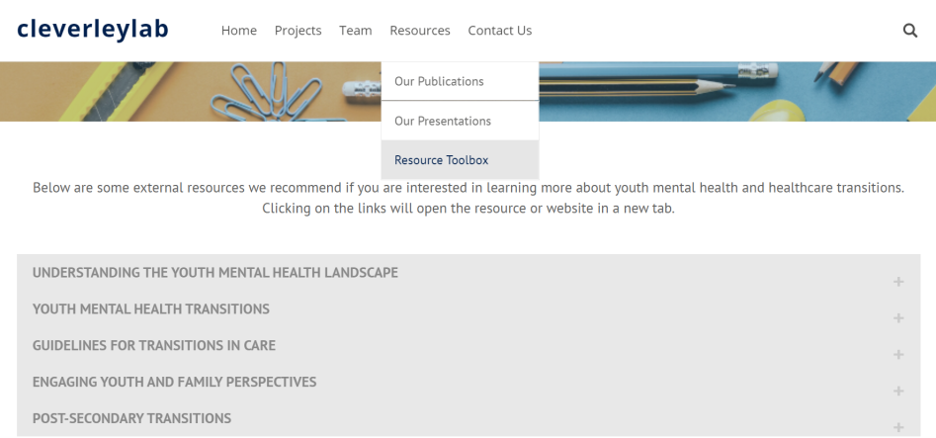
Resource Page

Slide 60
TRANSITIONS TOOLKIT
Operationalizing the Delphi core components in collaboration with youth, caregivers, and clinicians.

Slide 61
IMPLEMENTATION TRAINING
SickKids Centre for Community Mental Health Learning Institute
April 21 & 28, 2021

Slide 62

Transitions From Youth To Adult Health Care Services

Slide 63

End slide

