Slide 1






Innovating and Advancing Child
and Youth Mental Health
November 23 to December 4
Sponsored by

Slide 2
Culture, Connection, and Well-Being RELFECTIONS ON THE CHANGING TIMES, AND HOW ORGANIZATIONAL CULTURE AND CONNECTIONS IMPACT EMPLOYEE AND ORGANIZATIONAL WELL-BEING
MICHELE SPARLING
PARTNER, INNOVATIVE HR

Slide 3
Culture, Connection, And Well-Being
Reflections on the changing times, and how organizational culture and connections impact employee and organizational well-being

Slide 4
What a Year It Has Been!
Notes:
Was it truly this year that the fires raged in Australia?
Iran and the USA came close to a war?
Black Lives Matter
Stock market slide?
Beirut explosion?
Locusts in the Middle East?
And of course – the arrival of COVID.

Slide 5
Notes:
We met in person
We held out our M, V,V and lived by it, or at least tried
We gathered in office spaces, in communities.
We met as teams.
We met to talk about strategies, values.
We did surveys about how we work.
We did check-ins, gave feedback, and did reviews,
We addressed issues.
We trained and developed
We mentored
We connected with clients, families and colleagues

Slide 6
Notes:
Then March arrives.
The province shut down.
We are asked to work from home unless necessary.
We dispersed.
We pivoted.
Nothing was normal.
Our families were all together in our homes.
Spaces had to be found to work from at home.
Some had to continue working in the community, or in the office.
There were no policies for this; no guidelines, and we were flexible, and accommodating.
People applauded front line workers, coffee and food was sent over.
We checked in. We had regular gatherings to help alleviate the stress of staff.
We ensured the support was there in whatever form was needed.
We realized that doing our work online or via phone vs in person was not quite the same. Some needed training
We realized that facilitating meetings via zoom took on a new skill set.
We required new guidelines for compliance, for working from home and online.
We Went Online

Slide 7
Notes:
We learned new words and phrases, and introduced old but seldom used ones.

Slide 8
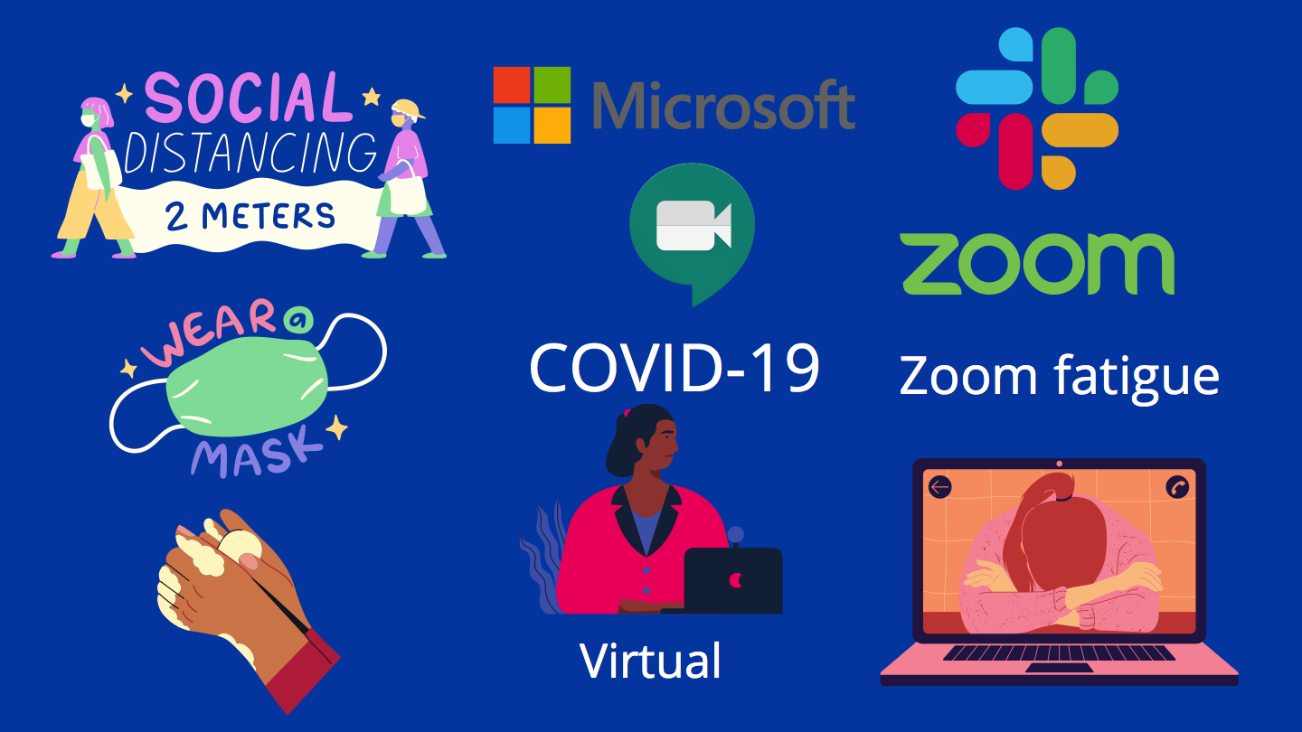
Notes:
There were other phrases that became part of our vernacular.
It wasn’t easy to make the pivot.
To be available on calls multiple times a day, to help clients via phone or online.
Days blended together
Home and work blended; no separation of the safe space.
Crisis workers working from home had no place to go to. Home was that safe space and then it wasn’t.
Hours increased for some over the months. Longer days or weeks because it was easy to check in, just send, join in, seeing how it was right there at home.
A new phrase entered – Zoom fatigue

Slide 9
Notes:
And just as we opened up, when it seemed like our numbers were going down, a second wave hit. And we were back into it again.
Except this time it was a little different.
We didn’t get the applause for front line workers.
The new normal was becoming normal as complacency set in.

Slide 10
ORGANIZATIONAL CULTURE, CONNECTIONS AND WELL-BEING
Notes:
So how do we ensure during such demanding times that we are still operating as a team, even when our team is at home, or half-and half, when offices require masks, physical distancing, Covid checklists, temperature checks?
How do we stay effective?
We do it by ensuring we have a positive culture.

Slide 11
ORGANIZATIONAL CULTURE
Notes:
THE CULTURE IS THE HEART OF THE ORGANIZATION
SOME define it as the personality of the organization.
Culture is the values, expectations, and practices of the organization; how it behaves.
Culture defines connections and relationsips within the organization whether they are internal or external connections, which in turn impact the well-being of the organization and the individual.
It is brought into action through how we connect with others.
Culture is taking the mission, vision, and values from, words to actions.
Values such as:
Teamwork
Respect
Client-centered
Health and well-being
Collaboration
Excellence
Accountability
Inclusivity
Innovation
Leadership

Slide 12
CONNECTIONS
Notes:
More time is spent at work than anything other activity in a day/week.
It’s important that an employee feels connected and supported by peers, direct reports, and their leaders.
Connection is relationships, and its not always easy to change how we relate or connect but in this case there was not choice.
Connection is a sense of value, a sense of worth, a sense of recognition.
Research shows strong social connections are important for physical and mental well being.
Not in the office? working solo? It is important that there is a concerted effort to connect employees and to allow them to make connections – and we are not just talking about tools or resources, its about deliberate actions.
A study by McKinsey and Company in June 2020 article, “Covid19 and the Employee Experience showed a strong correspondence between employee’s stated needs and social cohesion and inclusion as underlying drivers of their engagement, well-being, and work effectiveness.
Trusting work relationships - where employees work with people they trust in leadership had a 45.4% improvement in well-being, trust of the company had a 51.3 improvement. Being treated fairly 52.3%, engagement 51.1% , and having supportive co-workers - respected 49.8% and equality 50.9%.
Connections - healthier life, longer life, fewer cardio vascular, better immune, lower levels of cortisol, more relaxed

Slide 13
WELL-BEING
Notes:
Well-being is both for employees and for organization
It is the quality and safety of the physical environment,
how workers feel about their work,
The working environment,
the climate at work and work organization.
how they connect and relate
Well-being is a key factor in determining an organisation's long-term effectiveness

Slide 14
Wellbeing
Connection
Culture
Notes:
Culture is like the personality of the organization, the soul, or the DNA.
Culture defines, connections within the organization whether they are internal or external connections, which in turn impact the well-being of the organization and the individual.
Culture can be supported through the policies and processes. When an organization talks about equity it may have flex time for staff, especially those who have home care issues, personal needs, etc. It may look to do coaching and development of individuals based on their interests and the opportunities to allow them to feel valued and recognized.
Culture looks like employees being encouraged to take breaks or days off.
Culture is created from the top down. There has to be ownership and accountability at all levels of the organization, it is not just the CEO or HR. It is about having an effective communications strategy that allows for sharing of information for employees to do their work and feedback. Employees want to know when there is a needs to improve.
There need to be presence of leaders who model the values of the organization, and in modeling, one such value is empathy – identified as a core value of businesses and business leaders.

Slide 15
Wellbeing
Connection
Culture
ORGANIZATIONAL CULTURE is not defined by words but ACTIONS and BEHAVIOURS
ORGANIZATIONAL CULTURE is
FOUNDATIONAL
ORGANIZATIONAL CULTURE can be
Healthy or Unhealthy
Notes:
Peter Ashworth CEO of Wells of Life states that organizational culture “defines for you and for all others, how your organization does business, how your organization interacts with one another and how the team interacts with the outside world, specifically your customers, employees, partners, suppliers, media and all other stakeholders.”
Culture can be healthy: strong communications, respect, employee engagement, shared values and vision, positive leadership., ethical, risk taking allowed, recognition, flexible, compliant, learning opportunities, collaboration, clear directions and expectations. Team-focused, live the MVV in everything they do; support staff to meet expectations; new skills/training
Culture can be unhealthy: no engagement, bottom-line driven, top down engagement, tokenism, no direction or strategy, ineffective leadership, lack of communications, bullying, bias / discrimination, harassment, lack of flexibility, lack of focus on employee safety and well-being; negative allowed to churn, no accountability or ownership; cut corners, no risk taking – blame and shame, ethical issues; tec.
Systemic biases can be imbedded in the culture and impact the well-being of others. Organizations need to look at their policies, processes, communications, engagement, leadership, opportunities, for evidence of bias and to work with employees or outside parties to ensure the lens used to address those biases being to those impacted by them.

Slide 16
Wellbeing
Connection
Culture
CONNECTIONS are CRITICAL
CONNECTIONS are INTERNAL and EXTERNAL
LACK of social CONNECTIONS can impact HEALTH
Notes:
Where connections are important for work:
Recruitment
Onboarding/orientation
Training
Expectations
Policies / processes
Compliance
Relationships – inside / outside the organization
Teambuilding
Value of solid connections are seen in:
Retention
Engagement
Bounce ideas off of/ build on
Social relations
Develop contacts
Exchange ideas
Mentoring
Support
Collaboration/cohesiveness
Reduce stress, increased resiliency
Less loneliness
NOTE: increased stress leads to increased absenteeism, increased illness , higher turnover, and lower productivity

Slide 17
Wellbeing
Connection
Culture
“WELLBEING comes from one place, and one place only — a POSITIVE CULTURE.” – HBR, Dec. 1, 2015
Notes:
A great deal of time is spent at work, the majority of our day in fact – commuting there, thinking about issues while mot working, sending an email during off hours, etc.
Positive workplace culture where there are positive relationships can have positive employee well-being., and in kind on the productivity, efficiencies, and innovations of the work place, among many other factors.
Trust is important to create a positive culture, and respect is also critical, along with integrity, dignity,.
Response to the crisis is important; response to managing employees is important but you need to be trusted, you need to have credibility to be seen as effective.
Connections are like bridges. Like any bridge you need to do maintenance or they wear out, and are more costly and take more time and effort to repair. It’s important that employees feel that they are truly in this together with you, that they are collaborating with you. A sense of cohesion can have positive impacts on engagement and wellbeing.
Having a sense of purpose, a sense of belonging, a sense of contributing helps employees feel valued.

Slide 18
IMPACT: Covid-19, Work, and Technology
April 2020
February, 2020
Notes:
Bréne Brown, - “A deep sense of love and belonging is an irresistible need of all people. We are biologically, cognitively, physically, and spiritually wired to love, to be loved, and to belong. When those needs are not met, we don't function as we were meant to. We break. We fall apart. We numb. We ache. We hurt others. We get sick.”
The challenge comes as technology, changes in workplaces, remote working, the pandemic, all cause us to change how we connect with each other.
It can be more difficult:
To ensure compliance with laws
To notice when someone is struggling
To keep a balance between home and work, when work is home
To ensure the relationships are developed/maintained
To onboard/engage new staff
To ensure vacation days are taken
It requires a concerted effort to ensure the connections are there, and a strategy is in place.
We are hearing people are fatigued from endless days of Zoom, trying to balance home and work. Building relationships, getting back to that call, that email, that text, even managing family issues and dynamics is becoming more of a challenge for employees and leaders. It can create dysfunction.

Slide 19
WATERCOOLER and LUNCHROOM TALK
Notes:
Conversations that naturally happened at work happen less when we are working remotely or not working at all. This is where we often learn about each other, our interests, our families, bounce ideas off, share insights, etc.
Leaning around the corner with an “Can I ask you something?”
Noticing that someone doesn’t seem to be themselves.
Ensuring that the new hire is doing ok, and is able to see and feel the culture of the organization.
Not having those naturally occurring opportunities makes it difficult.

Slide 20
BUT WHAT HAPPENS WHEN THERE IS NO WATERCOOLER or LUNCHROOM
Notes:
We spend a great deal of time on video calls; meetings are becoming more efficient at times - get in, get out, get moving on to the next call or issue.
There is less opportunity to connect. Less time to notice if something is wrong, if someone is not ok.
We cant assume that relationships that existed before can be maintained when remotely working or in isolation or when temporarily laid off in the same way. We need to make effort to ensure the relationships are still there.
And is a Friday karaoke enough? Not always. Some need that peer support that is not in a larger group setting or in a Zoom call.
We know that employees are telling us they need more than yoga and games night.
How do you ensure the natural occurring relationships develop and evolve? And is it your responsibility as an organization? The answer is YES – as we know that positive social connections at work in a positive work culture have an overall positive effect on health, productivity, engagement, etc.

Slide 21
Keeping the Balance
WFH
Engagement
Communications
RTO/C
Engagement
Communication
Connection
Connection
Notes:
Even returning back to work may mean a difference in how people connect and relate, depending on the rules, the ability to have staff at work, etc.
Staff may see ongoing remote working, full return to the workplace, or a combination of the two. This can make for challenging dynamics when it comes to social connection, and how they see each other. It is easy to do out of sight, out of mind for those working away from the office, and notice only those in the office.
Staff will need to feel a sense of belonging if they are still at home and their colleagues are at work, or if everyone is still working remotely, a decision some organizations have made. Understand the worry is still there. Recognize that employees have different needs. Develop a communications plan to ensure no one is left out.
It’s important to build the psychological safety which includes the social connection.
A pandemic, economic uncertainty, and social justice unrest has created stress for employees. When the pandemic first front line workers were lauded and applauded, including those in MH. Leaders did a lot to stay connected with staff, and it is easy to become complacent as time passes. It is still important to continue to check in, as circumstances can change for staff.
We know people are working longer hours when they are at home, which can lead to burn out, increased stress. It is easy because home and work are the same.
If health and safety or wellbeing is a value –it needs to be lived it whether they are at home or work.
Have those socially distant conversations with colleagues at the office and one-on-one video calls with your remote workers. Ask them about their individual circumstances; find out about their worries. Make your employees feel valued and belonging.

Slide 22
Wellbeing
Connection
Culture
ORGANIZATIONAL AND INDIVIDUAL
PEOPLE
FOUNDATIONAL
Notes:
The culture of an organization which is top-down driven determines a great deal of how an organization operates.
It is the foundation upon which everything else is built.
It needs to be decided up front. Once a culture is in place it is much more difficult to pivot without a radical shift in many systems.
It’s important for an organization that the culture is built on the values. We heard on Friday from Stephen De Groot that values are the most important of the 4 forces for employees. Ensuring employees know what the values are, want they look like in application, and seeing them modeled throughout the organization, especially in a crisis is critical.

Slide 23
An Ounce (or 28.35 gms) of PREVENTION is..
Notes:
Plan ahead.
Train staff on the importance of a positive work culture and how to promote and permit one. Have leadership deliver as it starts from the top. It can be just the leaders who are trained, everyone needs to be trained.
Build and invest in peer to peer and or individual employee opportunities
Psychological health and safety:
Inclusion
Risk taking
Recognition
No fear of reprisals
Communication channels
Review policies and processes for systemic biases
Engage employees in the planning and co-design of work changes, including return to work, return to office.
Be honest and open with what is happening for their work and the organization’s.
Culture
Involvement
Fairness
Respect
Equality/Equity.
Trust

Slide 24
Some, All, or None – FUTURE STATE
Notes:
So where do we go from here.
We know that there are outside pressures that influence employees – social justice issues, Covid-19 school, daycare, working from home that cannot be ignored by the organization. If an organization lives it’s values then it needs to be aware and address these matters.
We know that psychological health and safety is important in the workplace, and more so as we see a rise in social discord on values, bias, and hate
We know that maintaining a positive workplace culture with positive social connections is critical
We know bullying or demanding leadership can increase heart disease in employees.
We know that there are laws that protect employees from workplace violence, harassment and intimidation and this is where HR and Occ. Health and Safety can play a part to ensure a positive work culture.
Health costs in unhealthy cultures can be are greater, a significant number of workplace accidents can be attributed to stress, disengaged employees who feel not connected or attached can have higher absenteeism, there increase in accidents, error rates or defects increase, and there is a increase in turnovers.

Slide 25
Wellbeing
Connection
Culture
POSITIVE organizational CULTURE
+
POSITIVE
CONNECTIONS
=
IMPROVEMENT in Employee
WELLBEING
Notes:
Positive culture is good for your business and for employees.
Social connections doesn’t go away when people work remotely, they just happen differently.
Some Options:
Review your values and talk as a team about what they look like in the face of a crisis/pandemic.
Provide a space for social connections.
If employees are working remotely, create geographic social gatherings.
Create ’idea rooms’ or space’ for people looking to collaborate, share interests exchange information, get peer to peer support, talk hobbies, etc.
Pulse surveys/ check-ins.
Create a social connection strategy as part of the communication and employee engagement strategies.
Separation of work and home.
Build in social connection to the return to work/return to office strategies
Focus on social/emotional well-being in strategic planning and have accountability for it
Team building
Create communications channels
Recognize staff
Wellness challenges for the organization that include those who are remote
Don’t always make it about work.

Slide 26
QUESTIONS?

